Slide 1

TELECOM CHURN PREDICTION
Team Members​
Namrata Ingle​
Ankita Birari​
Siddhant Divekar​
Pooja​
Vaishnavi Pawar​
Shantanu Chanekar​
Ruchika​ Karoo

Slide 2

Business Problem
Customer churn is a big problem for telecommunications companies.
Indeed, their annual churn rates are usually higher than 10%.
Business Objective
To predict Customer Churn.
Highlighting the features/variables influencing
Customer Churn.
Use various Machine Learning Algorithms to
build prediction models, evaluate the
accuracy & performance of these model.
Finding out the best model for our business
problem & providing executive summary.

Slide 3
Project Flow
Data Collection
Exploratory Data Analysis & Feature Engineering
Model Building
Model Evaluation
Deployment

Slide 4

Data Set Details
Dataset : “Churn.csv”
The data set includes the following variables:
state: Categorical, for the 51 states and the District of Columbia.
Area.code
account.length: how long the account has been active.
voice.plan: yes or no, voicemail plan.
voice.messages: number of voicemail messages.
intl.plan: yes or no, international plan.
intl.mins: minutes customer used service to make international calls.
intl.calls: total number of international calls.
intl.charge: total international charge.
day.mins: minutes customer used service during the day.
day.calls: total number of calls during the day.
day.charge: total charge during the day.
eve.mins: minutes customer used service during the evening.
eve.calls: total number of calls during the evening.
eve.charge: total charge during the evening.
night.mins: minutes customer used service during the night.
night.calls: total number of calls during the night.
night.charge: total charge during the night.
customer.calls: number of calls to customer service.
churn: Categorical, yes or no. Indicator of whether the customer has left the company (yes or no).

Slide 5
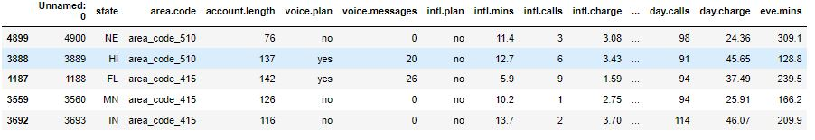
Exploratory Data Analysis
Exploratory Data Analysis (EDA) is an approach to analyse data set & to summarize their main characteristics, often with visual methods.
Shape of Dataset :
5000 Rows,
21 Columns
Null Values :
31
‘Day charge’ : 7
‘Eve Min. ‘ : 31
Target Variable :
‘Churn’
Active Customers : 4293
Churn : 707
No duplicates are there in dataset

Slide 6

Data Visualization
(Data visualization using seaborn & matplotlib)

Slide 7
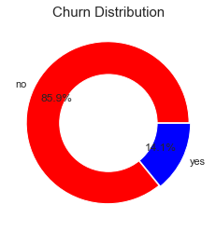
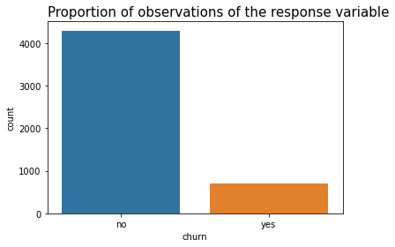
Churned customers : 14.1%
Active Customers : 85.9%
Users discontinuing the services are 707 in numbers
Users continuing their subscription plan are >80% i.e. 4293

Slide 8
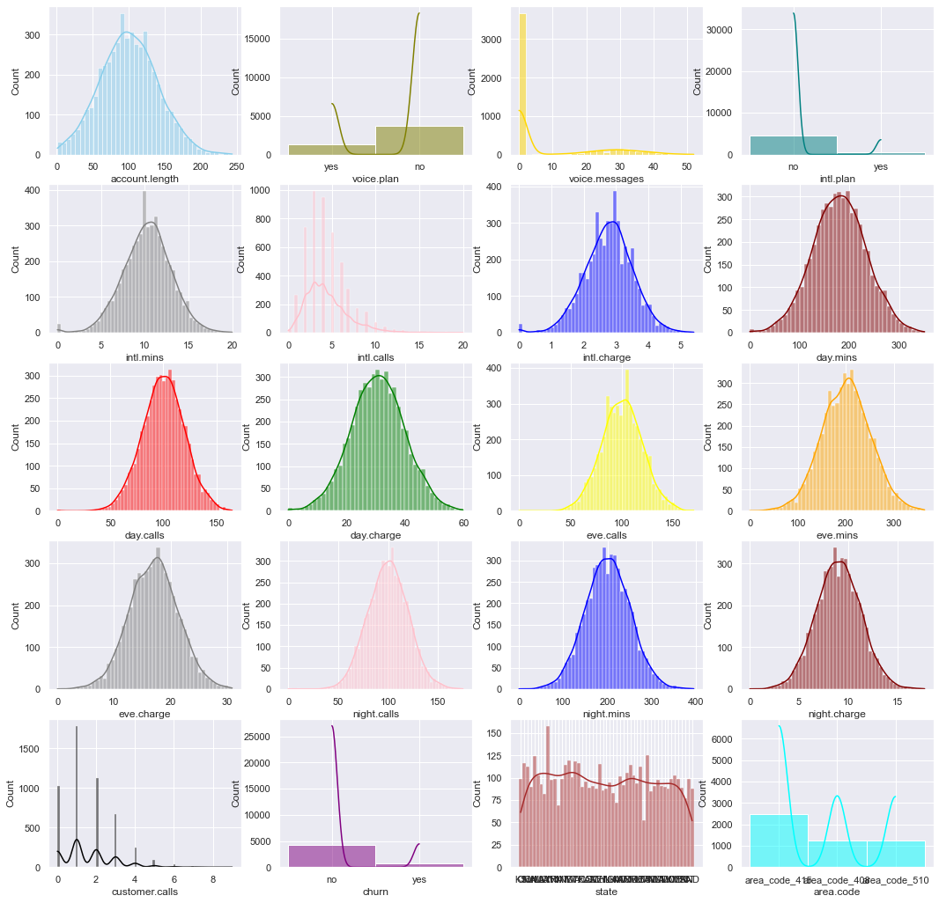
Data Distribution
Hence, as per above observation we can say that almost all the attributes are normally distributed except 'customer.calls' and 'intl.call' are slightly skewed towards right.

Slide 9
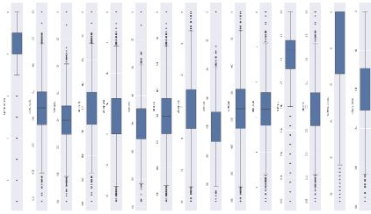
Outlier Detection
We found many outliers in maximum features which are out of whiskers.

Slide 10
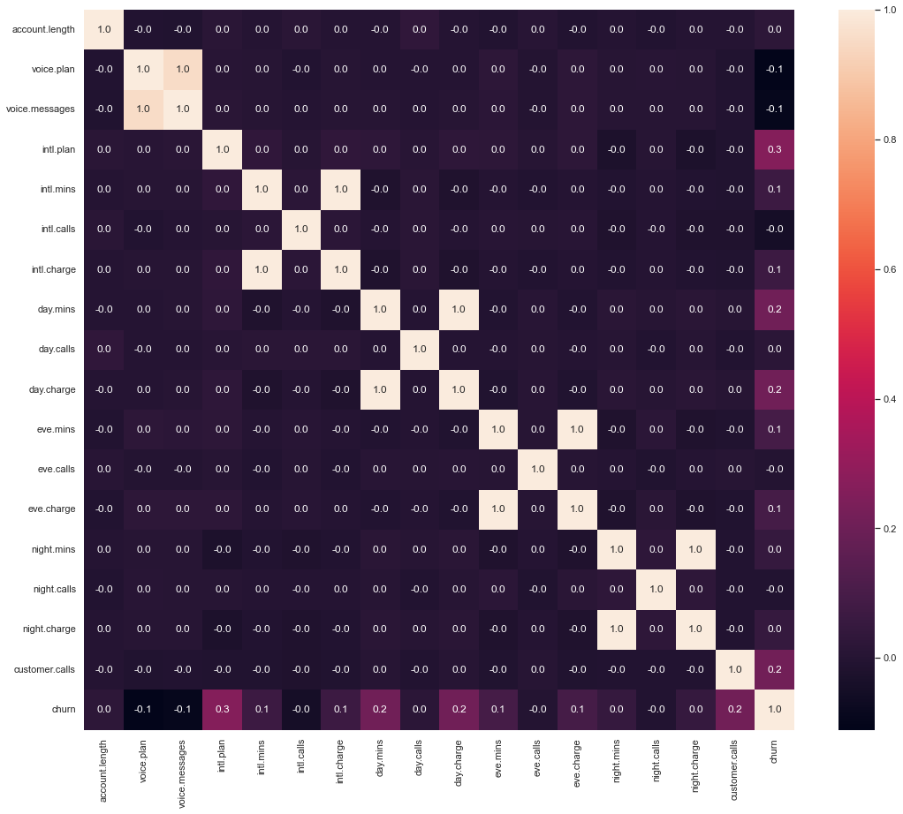
Correlation plot
With the help of correlation matrix we can find interdependency between variables.
Churn variable is depending more on ‘international charges’.
Whereas, ‘Voice msgs’ & ‘Voice plan’ are least affecting variables

Slide 11
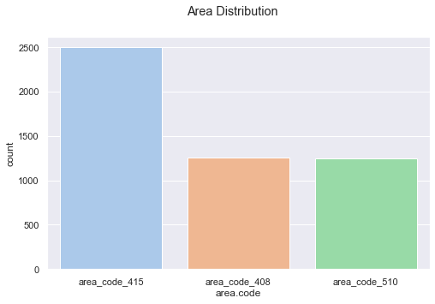
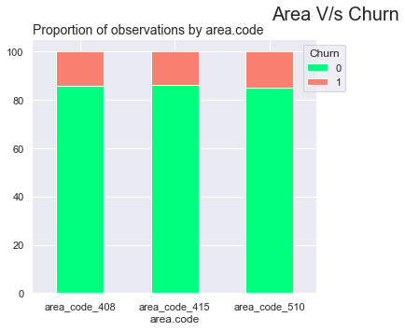
Churn by Area Code
area_code_415 : 2495 area_code_408 : 1259 area_code_510 : 1246
Hence, there is not that much of difference or fluctuations in churn rate when it comes to area.

Slide 12
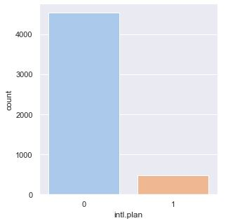
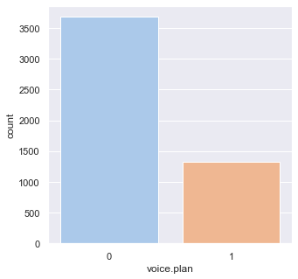
International plan
no 4527
yes 473
Voice plan
no 3677
yes 1323
With these graphs we can say that, the people opted for international plan are less as compare to voice plan.

Slide 13
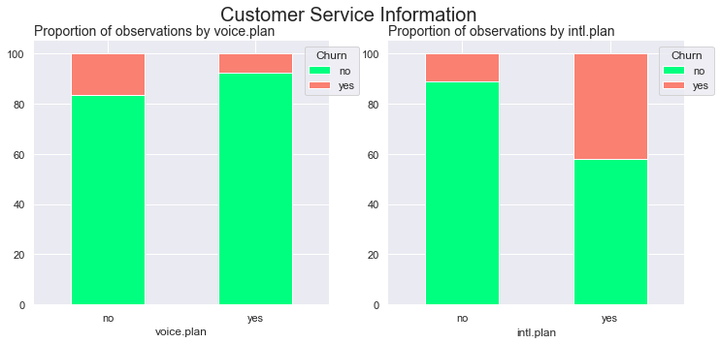
Churn by Plans
(Intl.plan, voice.plan)
The people who have taken the international plan are more likely to discontinue the company and churn rate is more in this case.

Slide 14
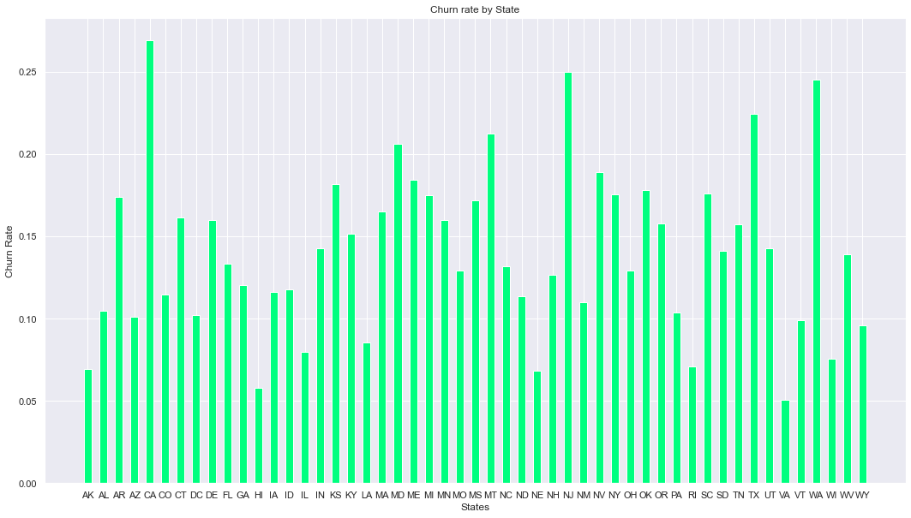
Highest churning rate : 26.92
Lowest churning rate : 5.08
Churn rate by State
5 Highest churning States
churn | 0 | 1 | Churn_%
state
MT | 78 | 21 | 21.212121
TX | 90 | 26 | 22.413793
WA | 74 | 24 | 24.489796
NJ | 84 | 28 | 25.000000
CA | 38 | 14 | 26.923077
5 least churning States
churn | 0 | 1 | Churn_%
state
VA | 112 | 6 | 5.084746
HI | 81 | 5 | 5.813953
NE | 82 | 6 | 6.818182
AK | 67 | 5 | 6.944444
RI | 92 | 7 | 7.070707

Slide 15
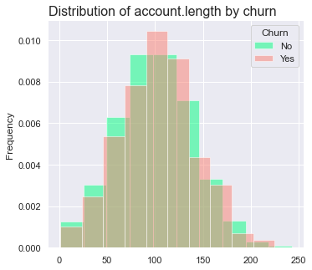
Churn by Account length
Customers who disconnecting their subscription
plans are selecting short tenure.
Telecom company need to offer better plans for
those customers who chose short tenure

Slide 16

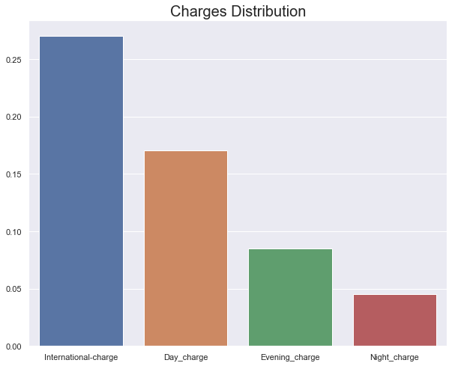
Charges Distribution
Hence we can see that, international charges are very much high as compare to others.

Slide 17
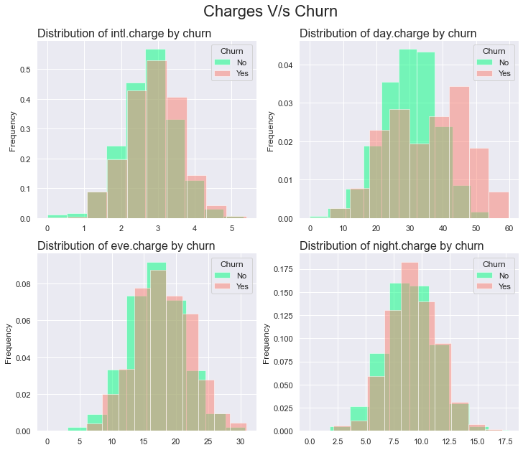
Churn by Charges
Churn Rate is pretty much affected by international charge, evening
charge & day charge
Whereas, variable night charge is not affecting that much.

Slide 18

Feature Engineering
Feature Engineering
Drop Unwanted features:
After dropping ‘Unnamed 0’
Shape of the dataset is : 5000 rows & 20 columns
Label encoding : label_encoder object knows how to understand word labels.

Slide 19

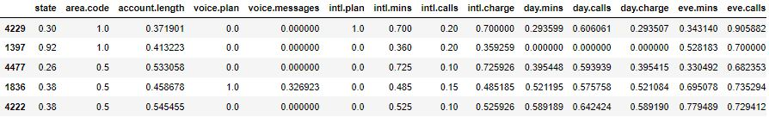
Normalization
Scaled data with Min –Max Scalar
Normalization : transforming numeric columns to a common scale
scaled numerical variables using min max scaler

Slide 20
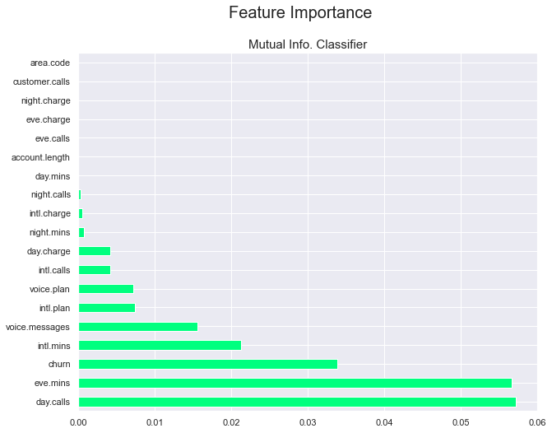
Hence, with less imporatnce we can drop day.mins,account.length,eve.calls,eve.charge,night.charge,customer.calls and area.code
13 Features are left for model building after dropping columns with less importance

Slide 21
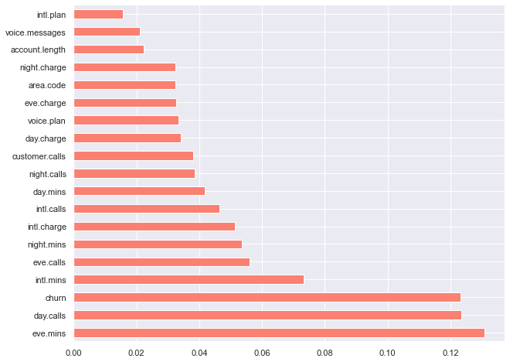
Feature Importance with Extra Trees Classifier
[0.03238622 0.02226757 0.0333061 0.02115079 0.01568729 0.07333387 0.04629556 0.05127513 0.04172867 0.123353 0.03398261 0.13080442 0.05602617 0.03267494 0.05351749 0.03853501 0.03236692 0.03805566 0.12325257]
Number of original features: 19 Number of reduced features: 4
Features left for MB : 15

Slide 22
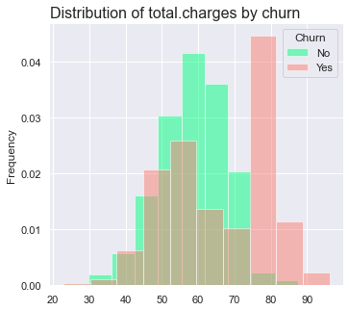
New Feature addition
Named : Total. charges
Total Charges = Sum(intl.charge,day.charge,eve.charge,night.charge)
Hence, we can see that total charges are affecting directly on churn rate
Higher the charges higher is the churn rate

Slide 23

Model Building & Evaluation

Slide 24
Using All 20 Features
Classifier : dummy_classifier, Accuracy: 0.857
Classifier : k_nearest_neighbors, Accuracy: 0.883
Classifier : logistic_regression, Accuracy: 0.86
Classifier : support_vector_machines, Accuracy: 0.865 Classifier : random_forest, Accuracy: 0.973
Classifier : gradient_boosting, Accuracy: 0.973
Hence, we can see that Classifier Gradient Boosting is giving maximum accuracy so we will go with it

Slide 25
Classification Report
 | Precision | Recall | F1-score | Support
0 | 0.97 | 1.00 | 0.98 | 1066
1 | 0.99 | 0.81 | 0.89 | 184
Accuracy |  |  | 0.97 | 1250
Macro avg | 0.98 | 0.90 | 0.94 | 1250
Weighted avg | 0.97 | 0.97 | 0.97 | 1250
Confusion Matrix
Accuracy: 96.899

Slide 26
Using 15 Features
Classifier : dummy_classifier, Accuracy : 0.857
Classifier : k_nearest_neighbors, Accuracy : 0.878
Classifier : logistic_regression, Accuracy : 0.858
Classifier : support_vector_machines, Accuracy : 0.868
Classifier : random_forest, Accuracy : 0.969
Classifier : gradient_boosting, Accuracy : 0.973
Hence, we can see that Classifier Gradient Boosting is giving maximum accuracy so we will go with it

Slide 27
Classification Report
 | Precision | Recall | F1-score | Support
0 | 0.97 | 1.00 | 0.98 | 1066
1 | 0.99 | 0.80 | 0.89 | 184
Accuracy |  |  | 0.97 | 1250
Macro avg | 0.98 | 0.90 | 0.94 | 1250
Weighted avg | 0.97 | 0.97 | 0.97 | 1250
Confusion matrix
Model Accuracy : 97.2
(856, 1)
(27, 116)

Slide 28
Using 14 Features
Classifier : dummy_classifier, Accuracy : 0.8528
Classifier : k_nearest_neighbors, Accuracy : 0.8768
Classifier : logistic_regression, Accuracy : 0.8512
Classifier : support_vector_machines, Accuracy : 0.8528
Classifier : random_forest, Accuracy : 0.9376
Classifier : gradient_boosting, Accuracy : 0.9368
Hence, we can see that Classifier Gradient Boosting is giving maximum accuracy so we will go with it

Slide 29
Classification Report
 | Precision | Recall | F1-score | Support
0 | 0.93 | 1.00 | 0.96 | 1066
1 | 0.99 | 0.57 | 0.72 | 184
Accuracy |  |  | 0.94 | 1250
Macro avg | 0.96 | 0.78 | 0.84 | 1250
Weighted avg | 0.94 | 0.94 | 0.93 | 1250
Confusion Matrix
Model Accuracy : 93.60
(3750, 13)
(1250, 13)

Slide 30
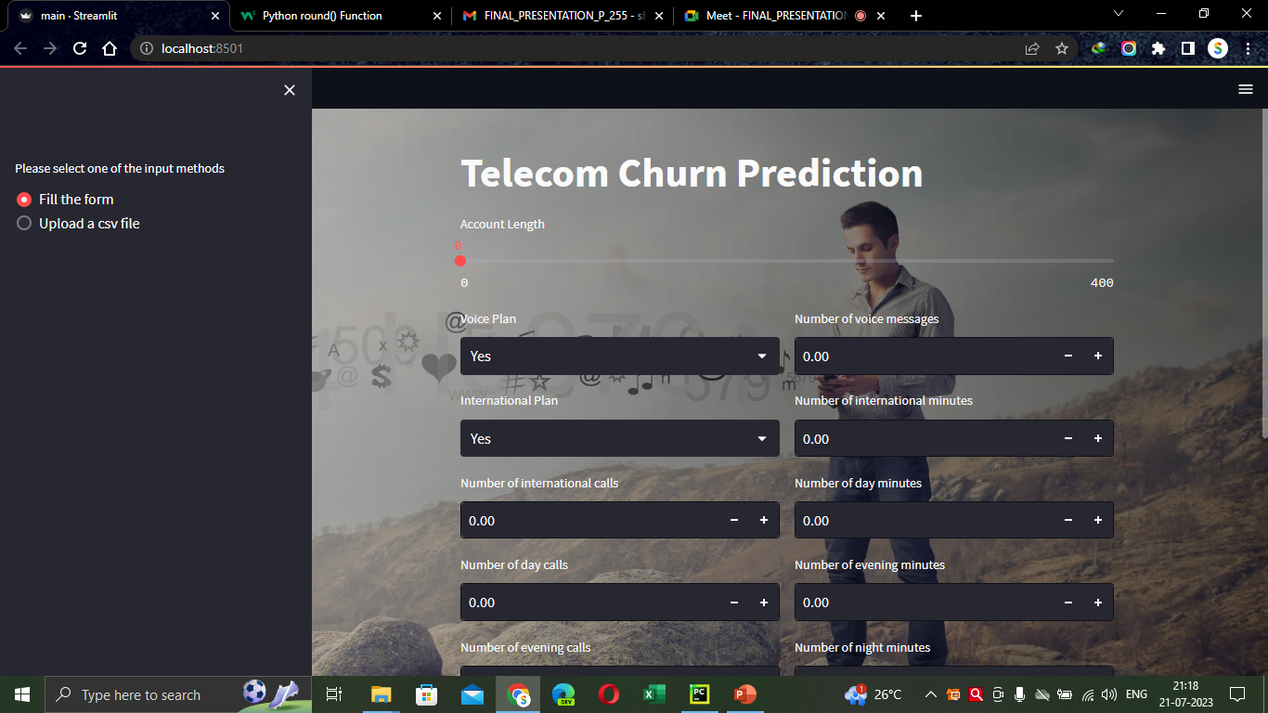
Layout 1

Slide 31
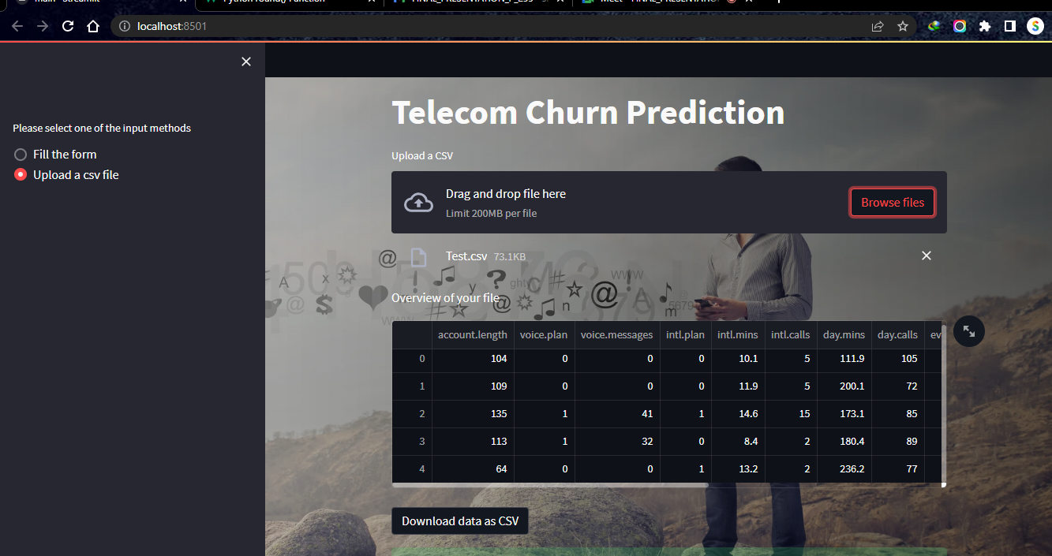
Layout II

Slide 32

THANK YOU

